Slide 1
EMAT10001: Dealing with Uncertainty
Probability I
Andrew Calway

Slide 2
Random Experiments, Outcomes and Sample Spaces
Assuming a fair dice:
Outcomes are
equally likely
Probability that outcome is 4 =
Random
experiment
Outcome
Sample space
Ω
Not a fair dice!

Slide 3
Events
< 4
event
✔
✖
> 4
event
Ω
Elementary event

Slide 4
Probability of an Event
Assuming equally likely outcomes
Outcome must be
in sample space:
Impossible event:

Slide 5
Probability by Counting
Conduct experiment times.
Event occurs times.
Relative
frequency

Slide 6
Not Equally Likely
Sometimes (in fact, often) outcomes and hence events
are not equally likely, e.g. biased dice or coins
We represent using weights:
High weight more likely outcome
Low weight less likely outcome

Slide 7
Flippin’ Example
Experiment : flip a fair coin 3 times
Record result of each flip
Each set of 3 recordings → outcome
Write down the sample space
Write down the subset of outcomes for the
following events:
at least 2 heads (b) at least 1 tail (c) exactly 1 head
Write down the probability of each event

Slide 8
Flippin’ Example

Slide 9
Complementary Events
< 4
Event
Ω
> 3
Complementary event

Slide 10
This OR That Event
HHT
HTH
THH
HHH
HTT
TTH
THT
Mutually
exclusive

Slide 11
`Overlapping’ Events
HHH
HTH
THH
HHT
HTT
THT
TTH
TTT

Slide 12
Conditional Probability
: Event that first flip gives T
HHT
Probability of given :
HTH
HHH
THH
THT
TTH
TTT

Slide 13
Independent Events
Two events are independent if the occurrence of
one does not affect the probability of the other.

Slide 14
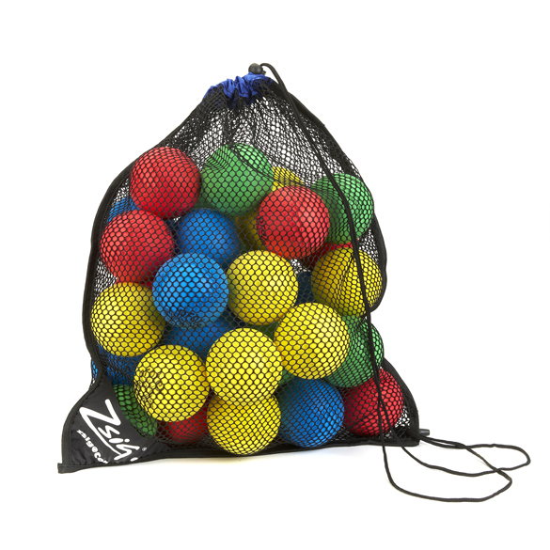
Example
3 red balls & 2 blue balls in bag
Probability that I will draw a red ball followed by a blue ball, assuming no replacement?

Slide 15
Permutations and Combinations
# permutations of k
out of n items
# combinations of k
out of n items

Slide 16
Gambling
Probability of getting flush (cards all same suit) in 5 card poker
52 cards in pack, 4 suits, 13 cards in each suit.
# 5 card hands :
# possible flush hands :
Not a lot

